Slide 1
Mecanum Motion Quiz
Mission to Mars

Slide 2
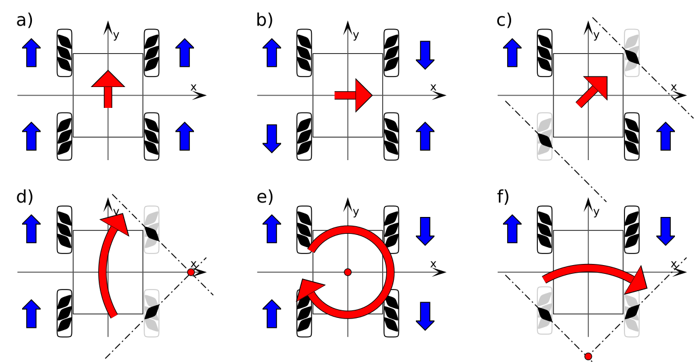
Which direction does the robot move?
Notes:
forward

Slide 3
Which direction does the robot move?
Notes:
forward

Slide 4
Which direction does the robot move?
Notes:
right

Slide 5
Which direction does the robot move?
Notes:
right

Slide 6
Which direction does the robot move?
Notes:
diagonal right

Slide 7
Which direction does the robot move?
Notes:
diagonal right

Slide 8
Which direction does the robot move?
Notes:
turn right

Slide 9
Which direction does the robot move?
Notes:
turn

Slide 10
Which direction does the robot move?
Notes:
forward right curve

Slide 11
Which direction does the robot move?
Notes:
right curve

Slide 12
Which direction does the robot move?
Notes:
right curve

Slide 13
Which direction does the robot move?
Notes:
right curve

